Slide 1
This is the Title slide. Please add the course title in the Dummy Course Title section and duration of the course in the Course Duration section.
Please add the graphic description here.
Course Duration 01 hr. 00 mins.
Documentum D2 – Plugin Development
Extending D2
Notes:
Please add the audio note here.

Slide 2
Extending D2
This is the Overview slide. A brief overview of the content needs to be added here.
Please add the graphic description here.
Before customizing D2 using extensions, carefully re-examine the functionality available through D2 and its official plug-ins. In almost all cases, using existing capabilities to achieve your use cases provides a cheaper and more reliable solution.
D2 offers the following methods of extending D2 using the D2 API:
Building integrated solutions by using the D2FS
External Widgets – using Open Ajax Hub and JavaScript
Using D2 Java packages to create and configure D2 plug-ins
Click Play to continue.
Notes:
Please add the audio note here.

Slide 3
Agenda
This is the Objectives slide. The course objectives should be listed here.
The objectives should be tangible, achievable, and measurable.
Please add the graphic description here.
Overviewing the Architecture of D2
Understanding Custom Plug-ins
Overview of the Template Plug-in Examples
Downloading and Setting Up the Template Plug-in
Building, verifying and Deploying the Template Plug-in
Configuring a Menu Item for the Template Plug-in
Testing the plugin in D2 Client
Click Play to continue.
Notes:
Please add the audio note here.

Slide 4
Overviewing the Architecture of D2
This is the Separator slide which is used for separating the topics. Please write the topic name in the Separator Slide section.
Please add the graphic description here.
Click Play to continue.

Slide 5
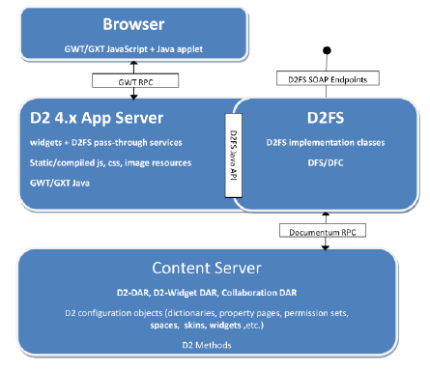
Overviewing the Architecture of D2
Please add the graphic description here.
D2 Client Architecture
Overviewing the Architecture of D2
Understanding the custom Plugins
Overview of Template Plugin examples
Downloading and setting up Template Plugin
Building and Verifying the template plugin
Configure the Menu item for custom Action
Click Play to continue.
Notes:
Please add the audio note here.

Slide 6
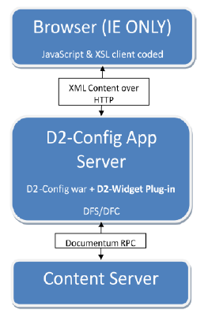
Overviewing the Architecture of D2
Please add the graphic description here.
D2 Config Architecture
Overviewing the Architecture of D2
Understanding the custom Plugins
Overview of Template Plugin examples
Downloading and setting up Template Plugin
Building and Verifying the template plugin
Configure the Menu item for custom Action
Click Play to continue.
Notes:
Please add the audio note here.

Slide 7
Understanding the custom Plugins
This is the Separator slide which is used for separating the topics. Please write the topic name in the Separator Slide section.
Please add the graphic description here.
Click Play to continue.

Slide 8
Understanding the custom Plugins
Please add the graphic description here.
You can create and configure custom plug-ins using the Java classes and resources packaged with the D2 API framework to:
Overviewing the Architecture of D2
Add features as custom actions
Modify existing features by changing pre-processing, post-processing, and overriding D2 services
Understanding the custom Plugins
Overview of Template Plugin examples
Downloading and setting up Template Plugin
Building and Verifying the template plugin
Configure the Menu item for custom Action
Click Play to continue.
Notes:
Please add the audio note here.

Slide 9
Overview of Template Plugin examples
This is the Separator slide which is used for separating the topics. Please write the topic name in the Separator Slide section.
Please add the graphic description here.
Click Play to continue.

Slide 10
Overview of Template Plugin examples
Please add the graphic description here.
The template plug-in located in the Plugins folder of the D2 4.5 SDK.zip archive contains the following three examples:
Overviewing the Architecture of D2
Customizing Content Export
This example for customizing content export shows how to use condition service override, how to add a custom service (IPluginAction), and how to configure error reporting.
Overriding a Service with Post-Processing
This example performs a D2 Service but adds post-processing to make object_name values uppercase.
Overriding a Service with Pre-Processing
This example performs a D2 Service but adds pre-processing to add a timestamp suffix to the title attribute.
Understanding the custom Plugins
Overview of Template Plugin examples
Downloading and setting up Template Plugin
Building and Verifying the template plugin
Configure the Menu item for custom Action
Click Play to continue.
Notes:
Please add the audio note here.

Slide 11
Downloading and setting up Template Plugin
This is the Separator slide which is used for separating the topics. Please write the topic name in the Separator Slide section.
Please add the graphic description here.
Click Play to continue.

Slide 12
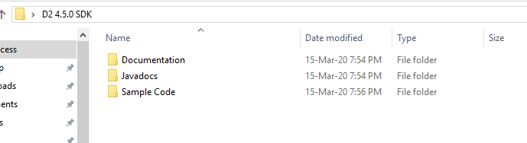
Downloading and setting up Template Plugin
Please add the graphic description here.
1. Download D2 4.5 SDK.zip to a temporary location.
2. Extract the Plugins folder from D2 4.5 SDK.zip
Overviewing the Architecture of D2
Understanding the custom Plugins
Overview of Template Plugin examples
Downloading and setting up Template Plugin
Building and Verifying the template plugin
Configure the Menu item for custom Action
Click Play to continue.
Notes:
Please add the audio note here.

Slide 13
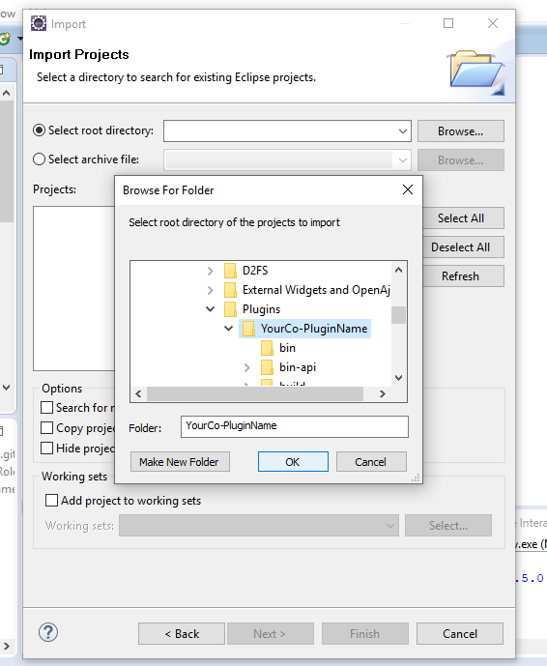
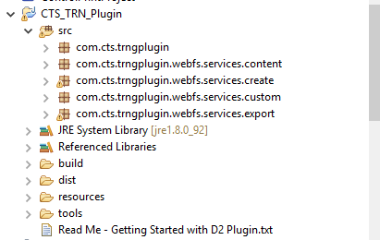
Downloading and setting up Template Plugin
Please add the graphic description here.
3. Open your IDE and select the extracted Plugins folder as a workspace.
4. Import the project to the workspace. In Eclipse:
a. Navigate to File > Import.
b. Select General > Existing Projects into Workspace and click Next.
c. In Select root directory, click Browse and select the YourCo-PluginName folder.
d. Click Finish.
Overviewing the Architecture of D2
Understanding the custom Plugins
Overview of Template Plugin examples
Downloading and setting up Template Plugin
Building and Verifying the template plugin
Configure the Menu item for custom Action
Click Play to continue.
Notes:
Please add the audio note here.

Slide 14
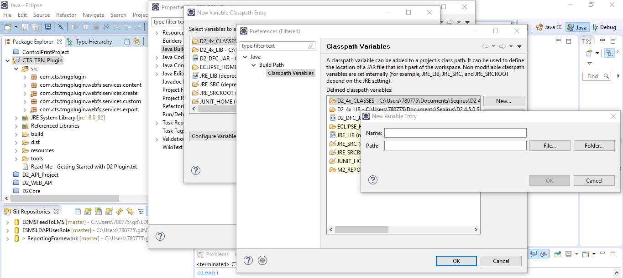
Downloading and setting up Template Plugin
Please add the graphic description here.
5. Configure the Java Build Paths for D2. In Eclipse:
a. Right-click YourCo-PluginName in the Package Explorer and click Properties.
b. Click Java Build Path in the Properties for YourCo-PluginName dialog box.
c. Click the Libraries tab.
d. Click Add Variable, then click Configure Variables.
Overviewing the Architecture of D2
Understanding the custom Plugins
Overview of Template Plugin examples
Downloading and setting up Template Plugin
Building and Verifying the template plugin
Configure the Menu item for custom Action
Click Play to continue.
Notes:
Please add the audio note here.

Slide 15
Downloading and setting up Template Plugin
Please add the graphic description here.
Add below variables:
Overviewing the Architecture of D2
Variable Name | Path | Example
D2_4x_LIB | WEB-INF/lib folder in the D2 web application. | C:/Program Files/Apache Software Foundation/Tomcat 6.0/webapps/D2/WEB-INF/lib
D2_4x_CLASSES | the WEB-INF/classes folder in the D2 web application | C:/Program Files/Apache Software Foundation/Tomcat 6.0/webapps/D2/WEB-INF/classes
D2_DFC_JAR | Path to the folder containing DFC.jar file. | C:/emc-dfs-sdk-6.7.2/lib/java/dfc/dfc.jar
Understanding the custom Plugins
Overview of Template Plugin examples
Downloading and setting up Template Plugin
Building and Verifying the template plugin
Configure the Menu item for custom Action
Click Play to continue.
Notes:
Please add the audio note here.

Slide 16
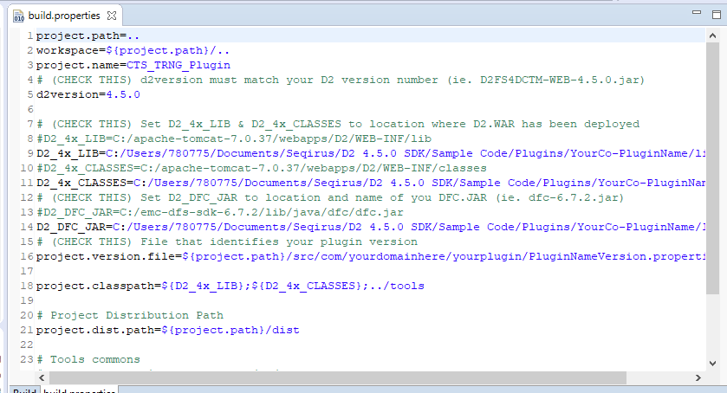
Downloading and setting up Template Plugin
Please add the graphic description here.
6. Edit build\build.properties to set D2_4x_LIB, D2_4x_CLASSES, and D2_DFC_JAR
variables for use by Ant build (using the same paths from above step).
Overviewing the Architecture of D2
Understanding the custom Plugins
Overview of Template Plugin examples
Downloading and setting up Template Plugin
Building and Verifying the template plugin
Configure the Menu item for custom Action
Click Play to continue.
Notes:
Please add the audio note here.

Slide 17
Building and Verifying the template plugin
This is the Separator slide which is used for separating the topics. Please write the topic name in the Separator Slide section.
Please add the graphic description here.
Click Play to continue.

Slide 18
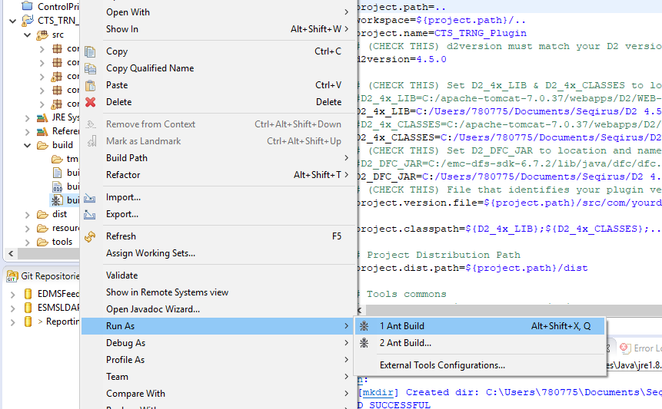
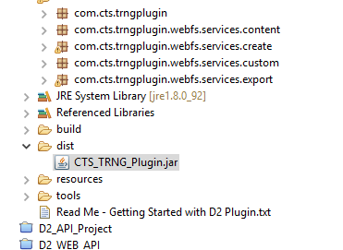
Building and Verifying the template plugin
Please add the graphic description here.
1. Build the plug-in:
a. In Eclipse, expand the build folder in the Package Explorer.
b. Right-click build.xml and navigate to Run As > Ant build
When your IDE finishes building the .jar file, the dist folder contains
YourCo-PluginName.jar.
Overviewing the Architecture of D2
Understanding the custom Plugins
Overview of Template Plugin examples
Downloading and setting up Template Plugin
Building and Verifying the template plugin
Configure the Menu item for custom Action
Click Play to continue.
Notes:
Please add the audio note here.

Slide 19
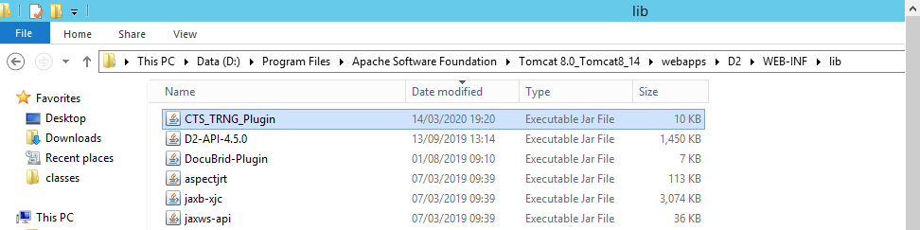
Building and Verifying the template plugin
Please add the graphic description here.
2. Stop the web application server.
3. Copy YourCo-PluginName.jar to the WEB-INF/lib folder of the D2 web application. For
example,
C:/Program Files/Apache Software Foundation/Tomcat
6.0/webapps/D2/WEB-INF/lib
Overviewing the Architecture of D2
Understanding the custom Plugins
Overview of Template Plugin examples
Downloading and setting up Template Plugin
Building and Verifying the template plugin
Configure the Menu item for custom Action
Click Play to continue.
Notes:
Please add the audio note here.

Slide 20
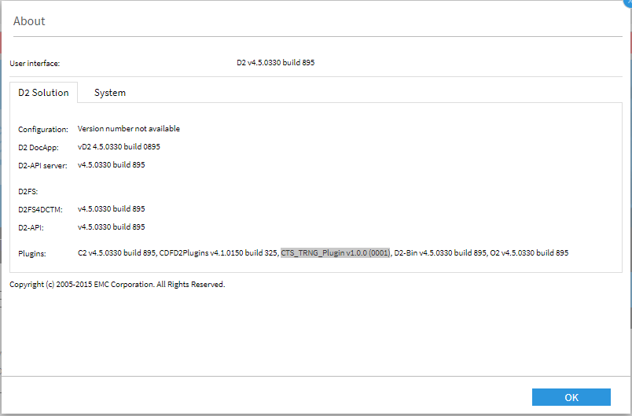
Building and Verifying the template plugin
Please add the graphic description here.
4. Start the web application server.
5. Verify the plug-in installation:
a. Log in to D2 Client.
b. Navigate to Help > About D2 from the menu bar.
c. Look for <Plugin-Name> v1.0.0 (0001) in the list of Plugins.
Overviewing the Architecture of D2
Understanding the custom Plugins
Overview of Template Plugin examples
Downloading and setting up Template Plugin
Building and Verifying the template plugin
Configure the Menu item for custom Action
Click Play to continue.
Notes:
Please add the audio note here.

Slide 21
Configure the Menu item for custom Action
This is the Separator slide which is used for separating the topics. Please write the topic name in the Separator Slide section.
Please add the graphic description here.
Click Play to continue.

Slide 22
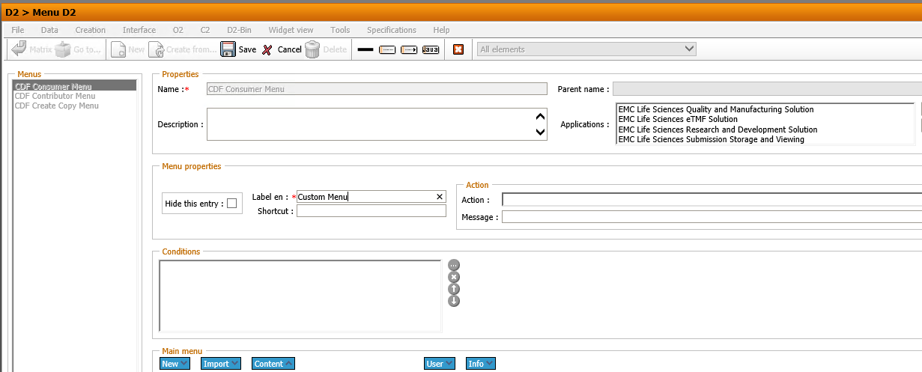
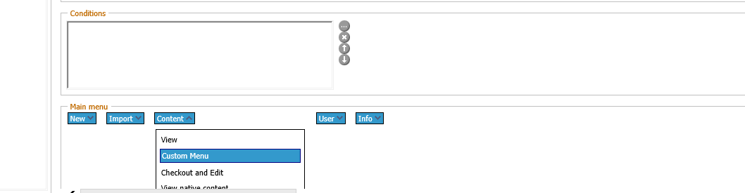
Configure the Menu item for custom Action
Please add the graphic description here.
1. Log in to D2 Config and navigate to Go to > Menu D2 to open the D2 Client menu configuration page.
2. Add a new menu item
Overviewing the Architecture of D2
Understanding the custom Plugins
Overview of Template Plugin examples
Downloading and setting up Template Plugin
Building and Verifying the template plugin
Configure the Menu item for custom Action
Click Play to continue.
Notes:
Please add the audio note here.

Slide 23
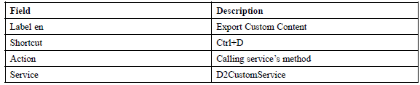
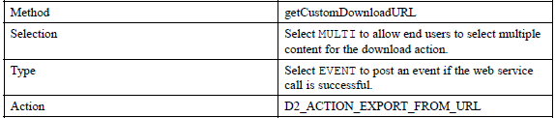
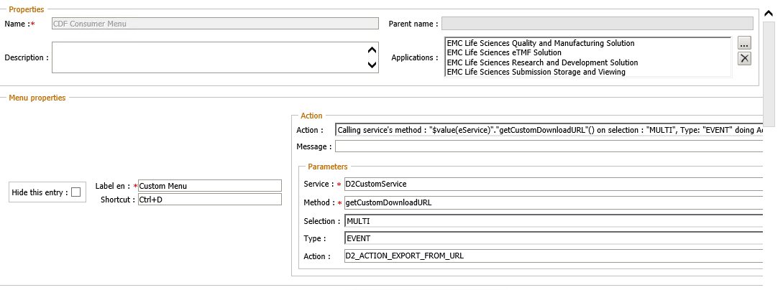
Configure the Menu item for custom Action
Please add the graphic description here.
3. Fill out the form for the new menu item as described in the following table.
Overviewing the Architecture of D2
Understanding the custom Plugins
Overview of Template Plugin examples
Downloading and setting up Template Plugin
Building and Verifying the template plugin
Configure the Menu item for custom Action
Click Play to continue.
Notes:
Please add the audio note here.

Slide 24
Summary
This is the Summary slide. A recap of the content should be added here and the summary points should map to the course objectives.
Please add the graphic description here.
From this course, you have learned:
Overviewing the Architecture of D2
Understanding Custom Plug-ins
Overview of the Template Plug-in Examples
Downloading and Setting Up the Template Plug-in
Building, verifying and Deploying the Template Plug-in
Configuring a Menu Item for the Template Plug-in
Testing the plugin in D2 Client
Click Play to continue.
Notes:
Please add the audio note here.

Slide 25
This is the Thank You slide.
Please add the graphic description here.
Thank You
Click the browser close button to exit the course.
Notes:
Please add the audio note here.

